Slide 1
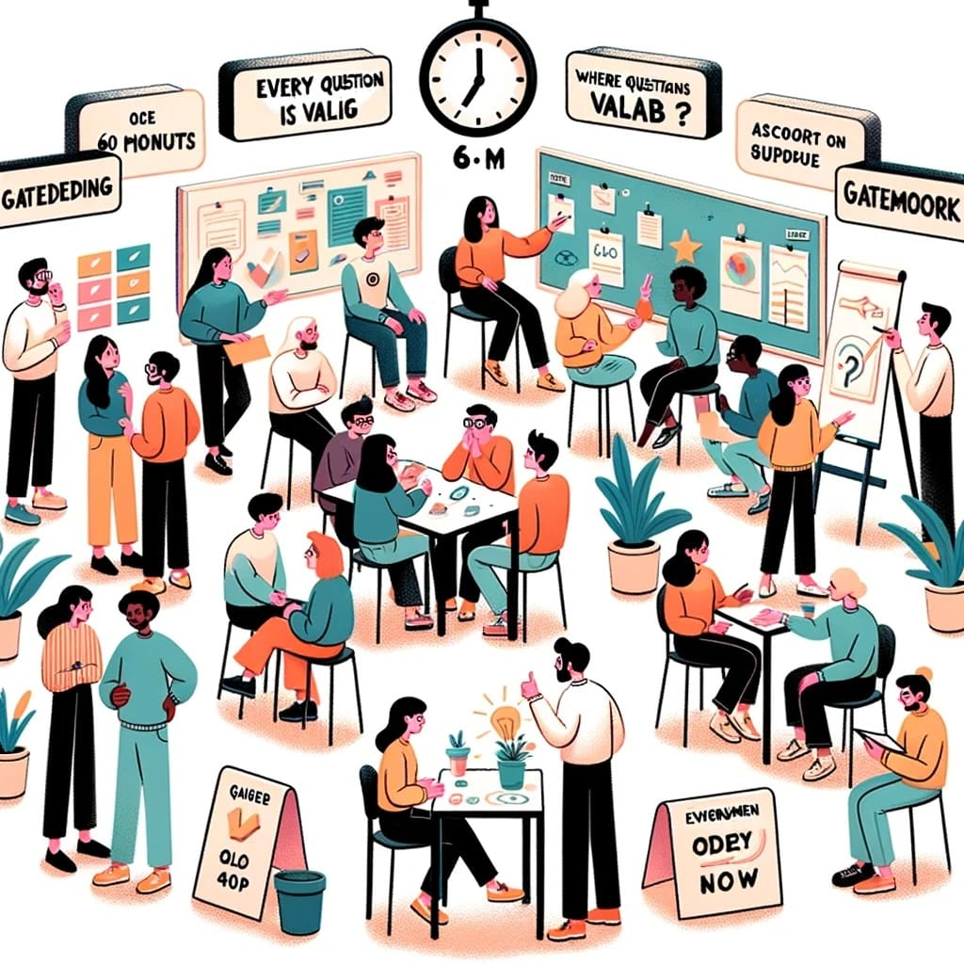

Bootcamp 2023 Summary
MANY THANKS TO
Nick Del Grosso
Mohammad Bashiri
Sangeetha Nandakumar

Slide 2
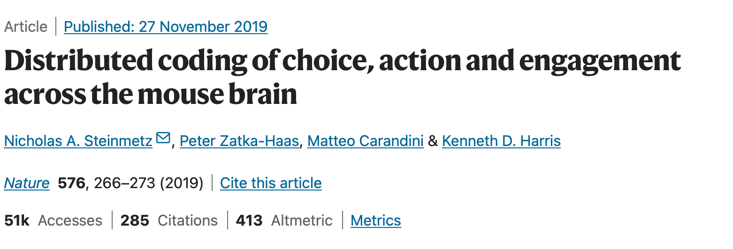
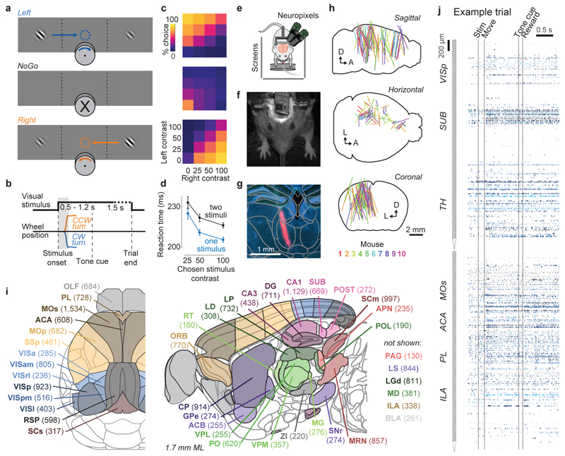
What did we do?

Slide 3
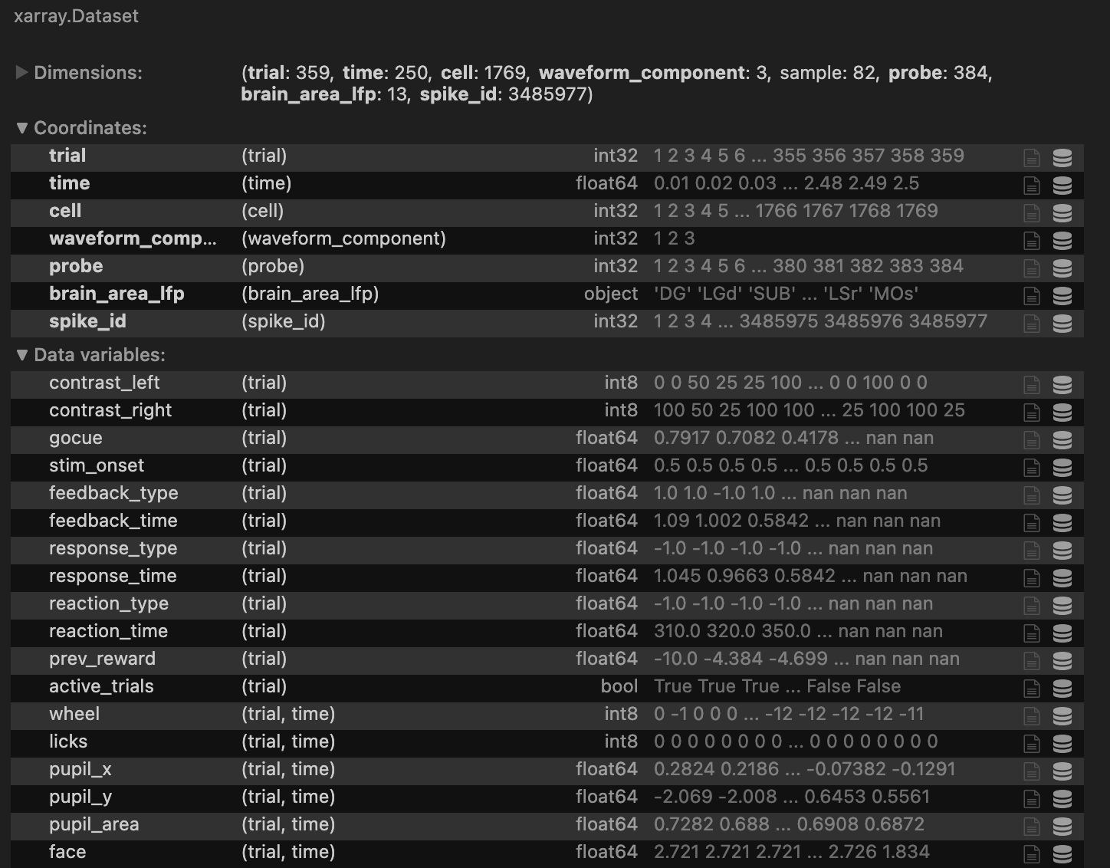
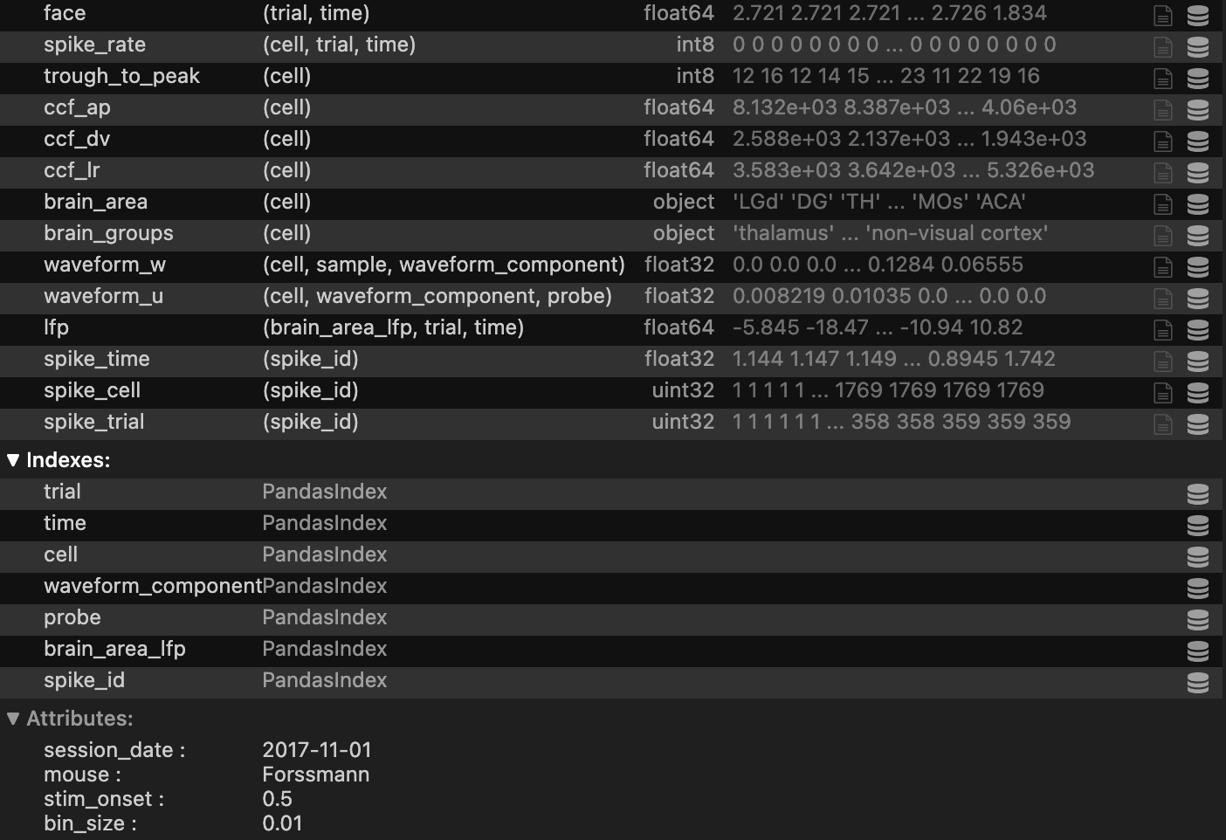
A peek into our dataset:
dataset = xr.load_dataset("/data/steinmetz_2017-11-01_Forssmann.nc")
10 mice & 31 different variables

Slide 4
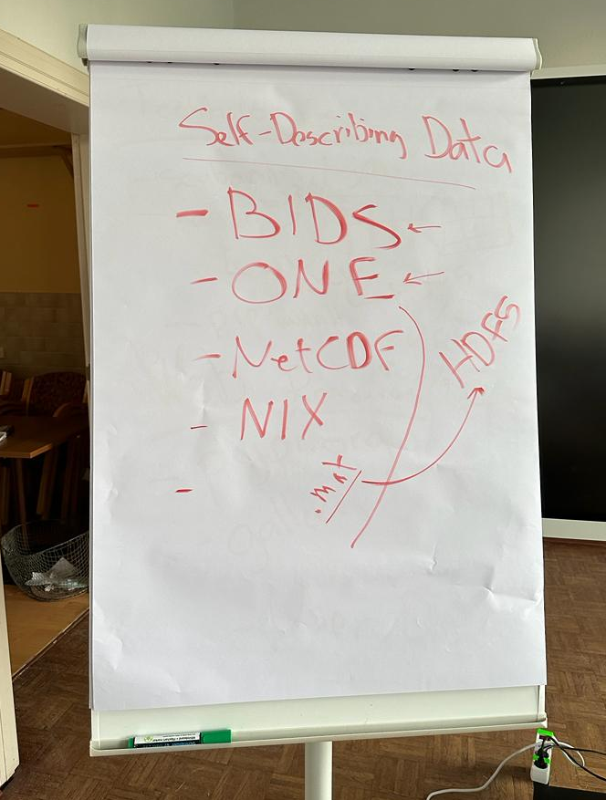
A peek into our dataset:
dataset = xr.load_dataset("/data/steinmetz_2017-11-01_Forssmann.nc")
10 mice & 31 different variables

Slide 5
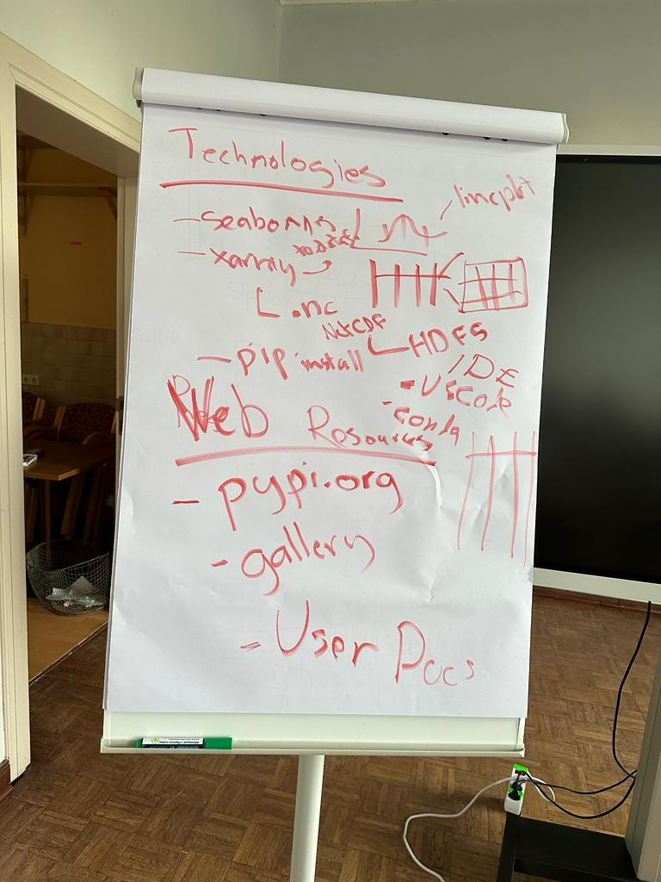



How did we explore the data?

Slide 6
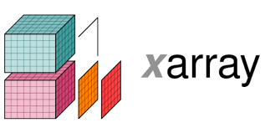



How did we explore the data?

Slide 7

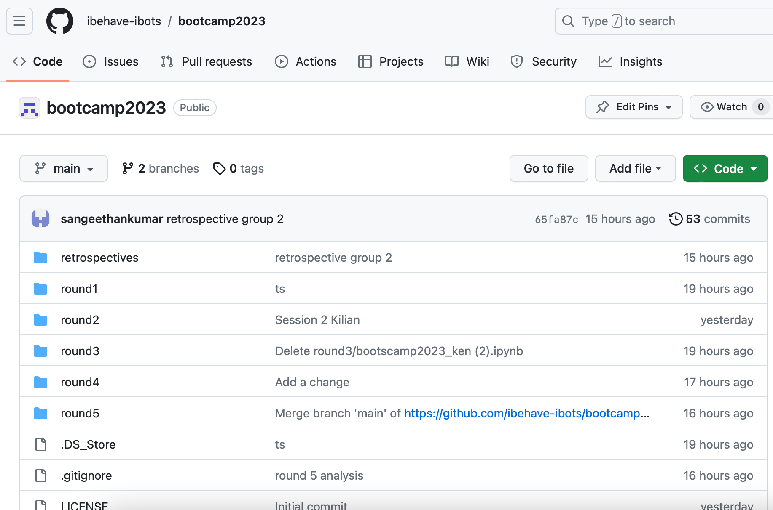
Our work “routine”

Slide 8
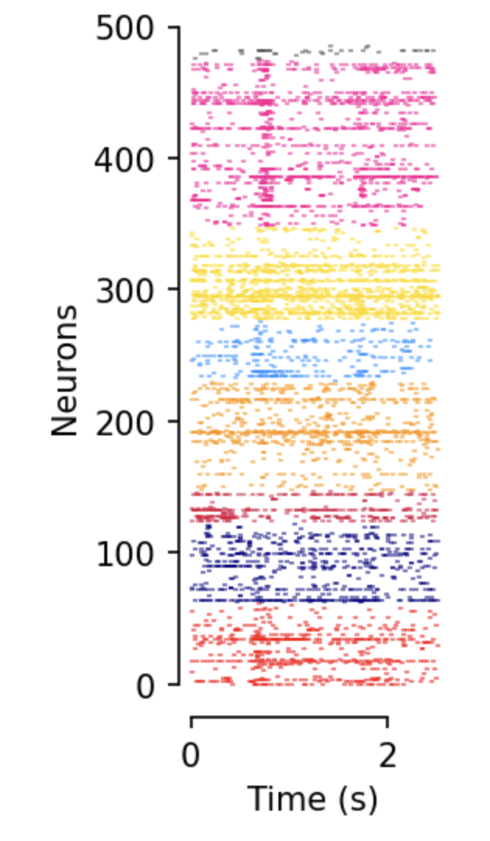
Outcome (the prettiest graphs ;) )
all_colors = {
'ACA' : "red",
'CA3' : "navy",
'DG' : "crimson",
'LS' : "darkorange",
'MOs' : "dodgerblue",
'SUB' : "gold",
'VISp' : "deeppink",
'root' : ".3",
}
Spike rasterplot
sorted by brain region
plt.figure(figsize=(1.5, 4), dpi=150)
plt.eventplot(spike_times_all_cells, linelengths=.8, colors=colors);
plt.xlabel("Time (s)")
plt.ylabel("Neurons")
sns.despine(trim=True)

Slide 9
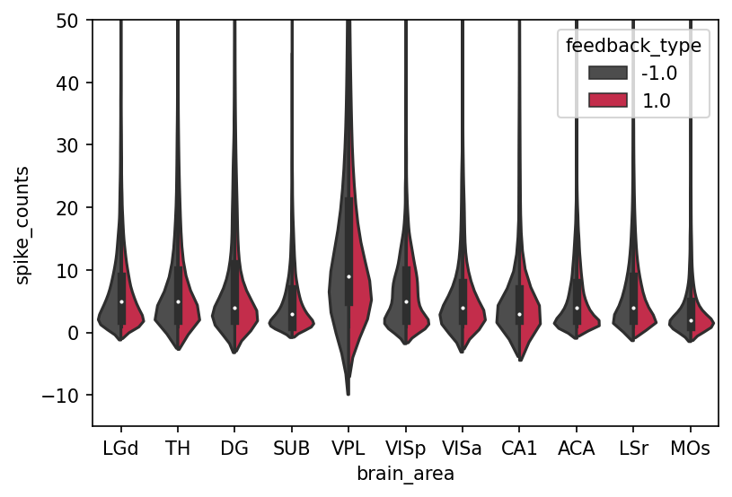
Outcome (the prettiest graphs ;) )
plt.figure(dpi=150)
sns.violinplot(data=df, x="brain_area", y="spike_counts", split=True, hue="feedback_type", palette=[".3", "crimson"])
plt.ylim(-15, 50)
Spike count per brain region for each feedback type

Slide 10
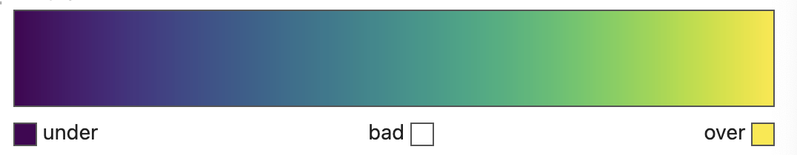
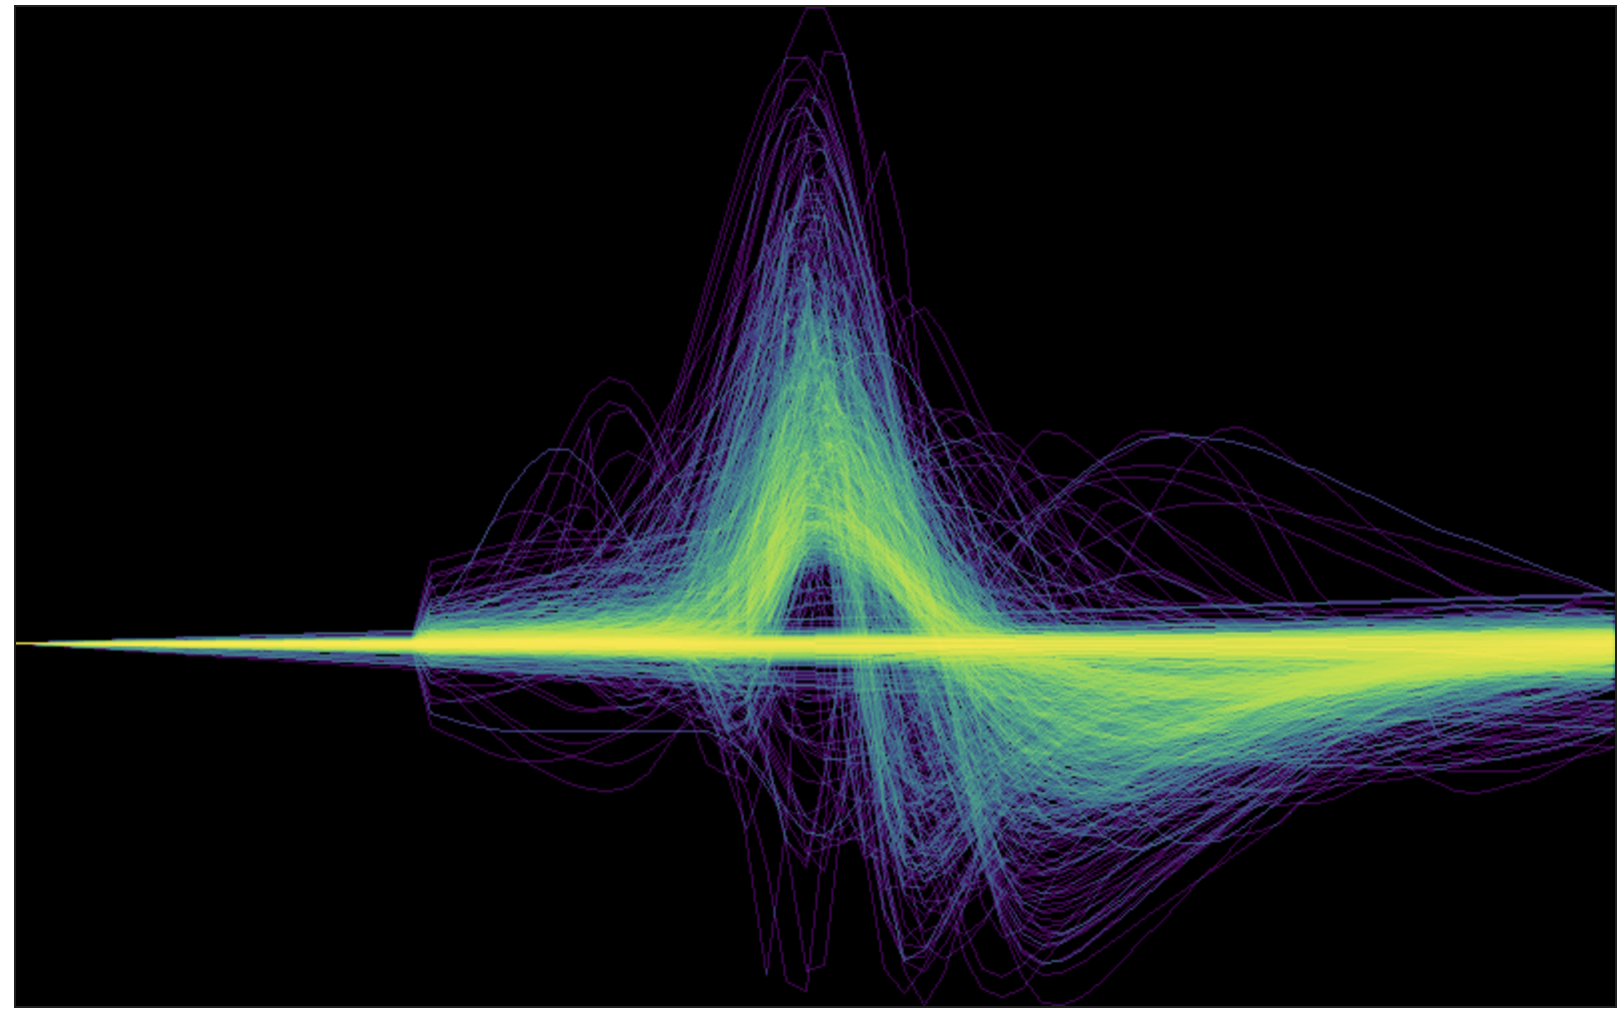
Outcome (the prettiest graphs ;) )
waveforms = dset.sel(waveform_component=1)['waveform_w'].to_dataframe().reset_index()
canvas = ds.Canvas(plot_width=800, plot_height=500)
agg = canvas.line(waveforms, 'sample', 'waveform_w', agg=ds.count())
img = tf.shade(agg, cmap=matplotlib.colormaps['viridis'])
img = tf.set_background(img, "black")
Wavelet transformation
(component visualization)

Slide 11
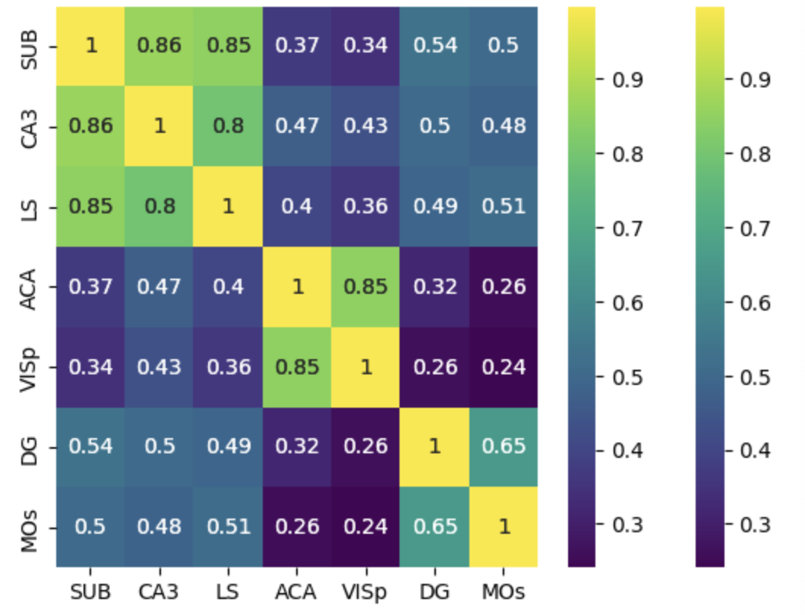
Outcome (the prettiest graphs ;) )
# Create a heatmap with labels
sns.heatmap(conn_mat_trial.mean(axis=2), annot=True, cmap='viridis',
xticklabels=labels_list, yticklabels=labels_list)
Heatmap of connectivity matrix between all brain regions

Slide 12
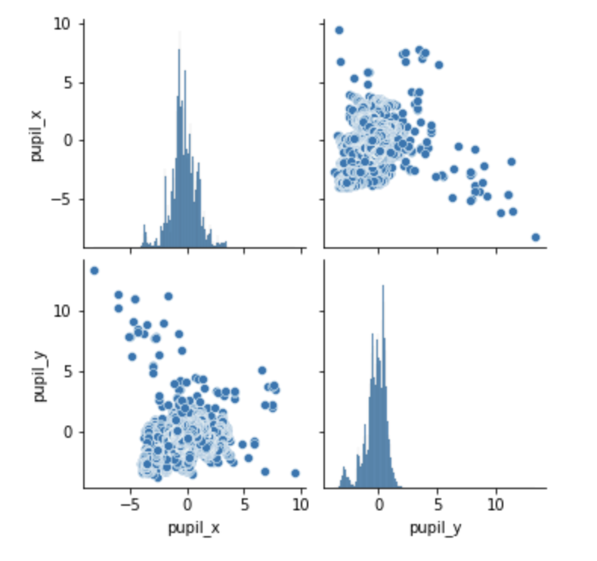
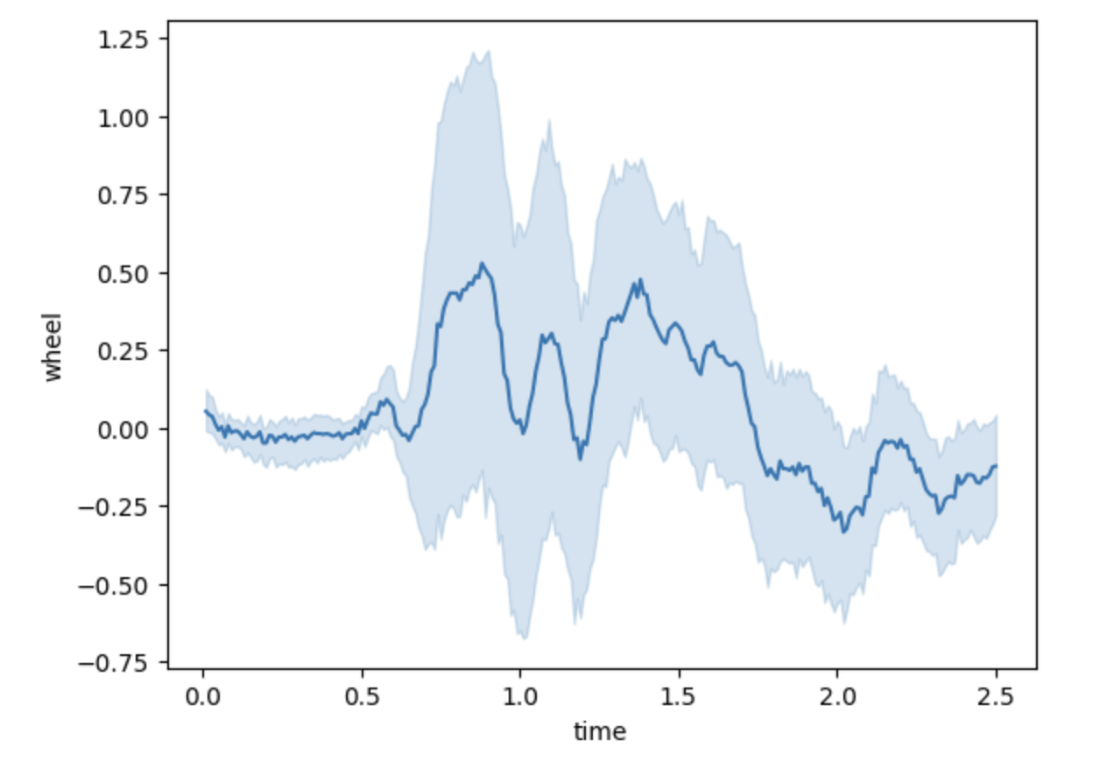
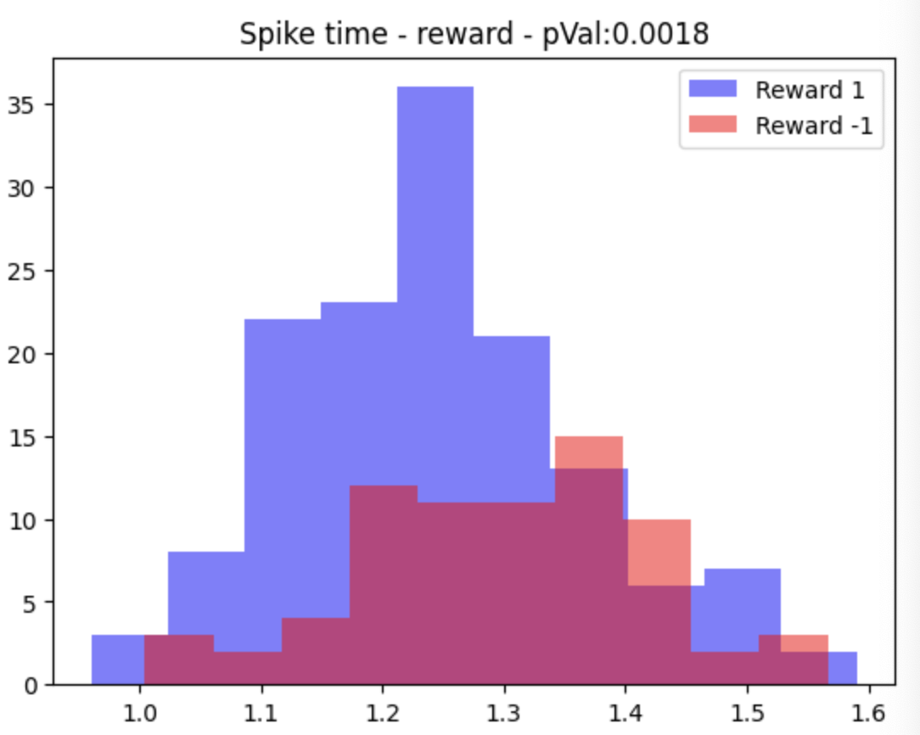
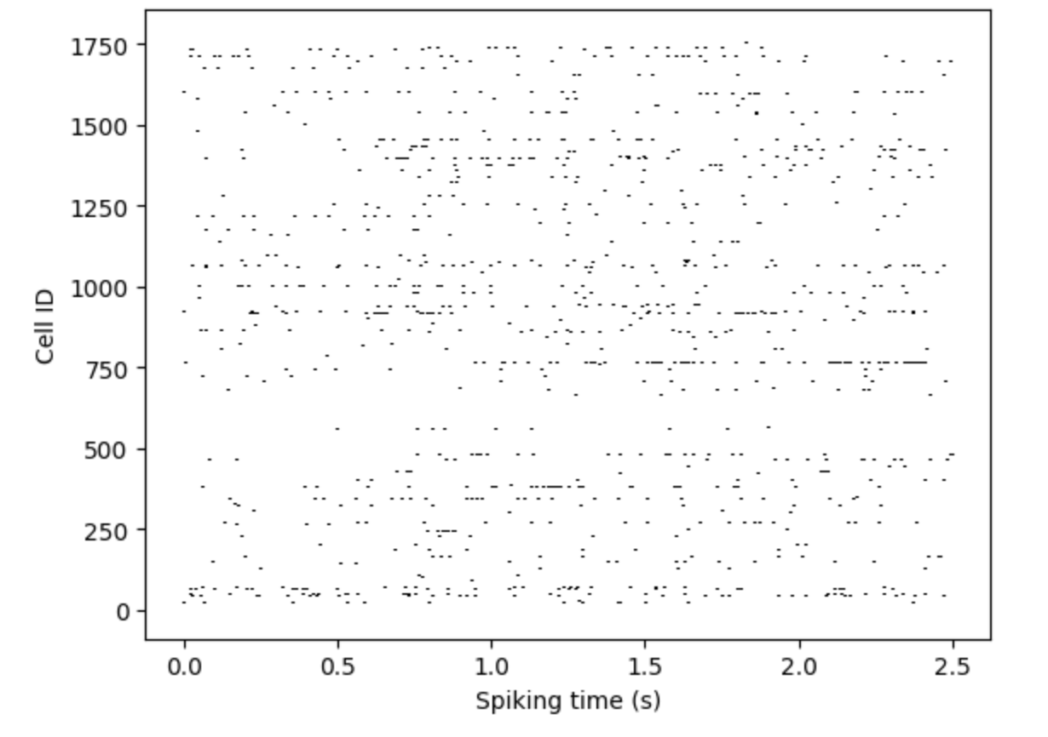
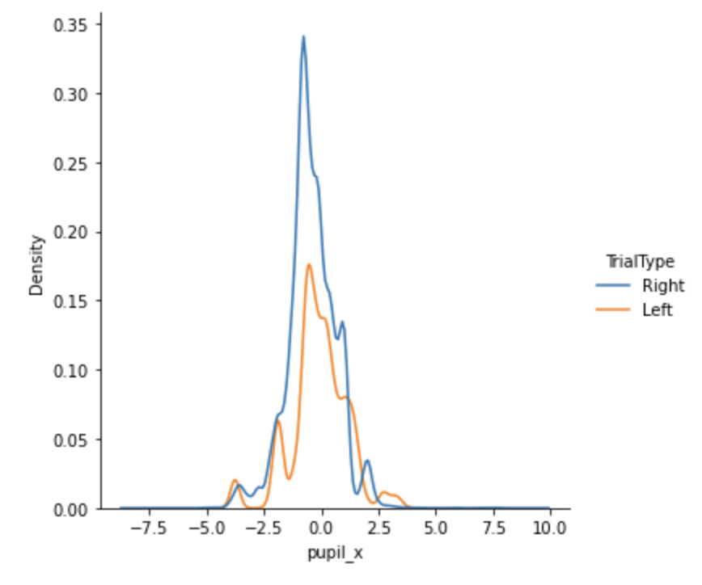
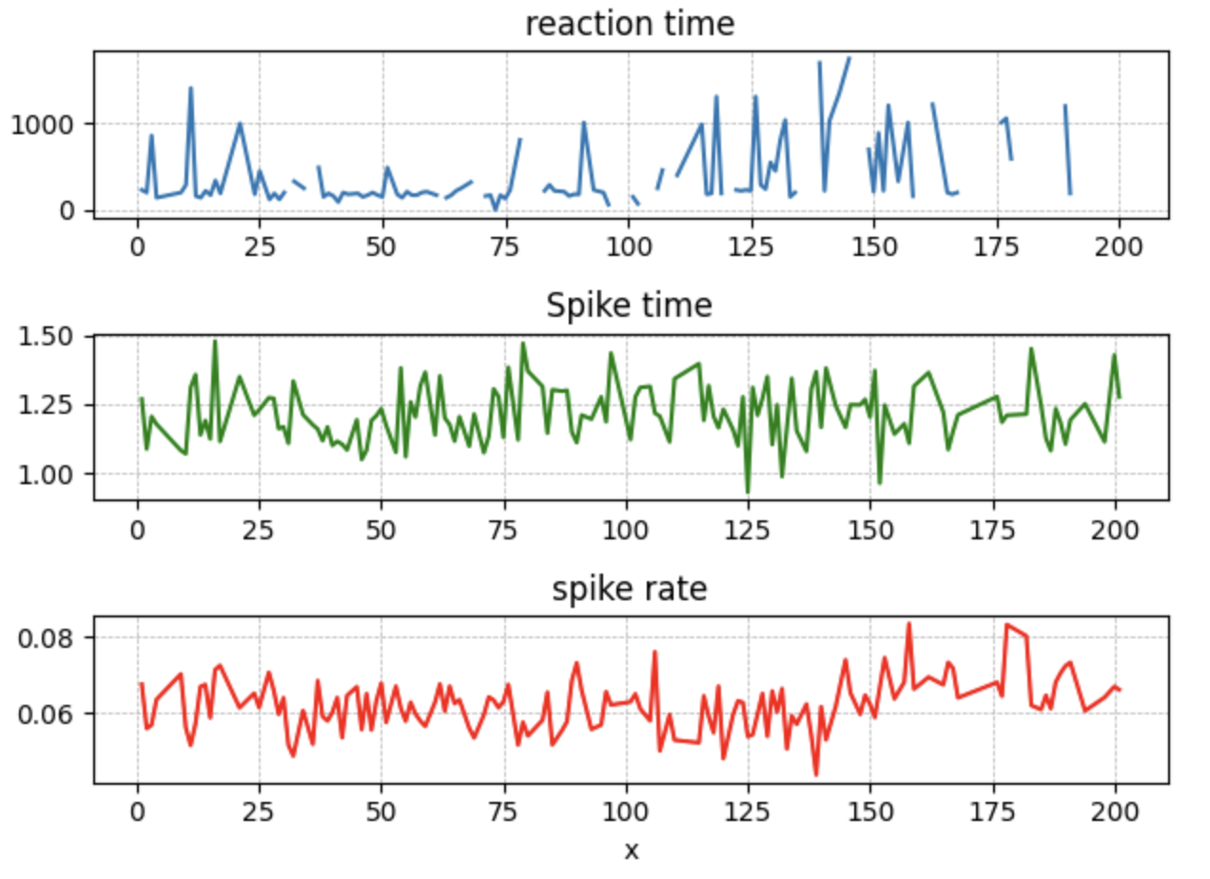
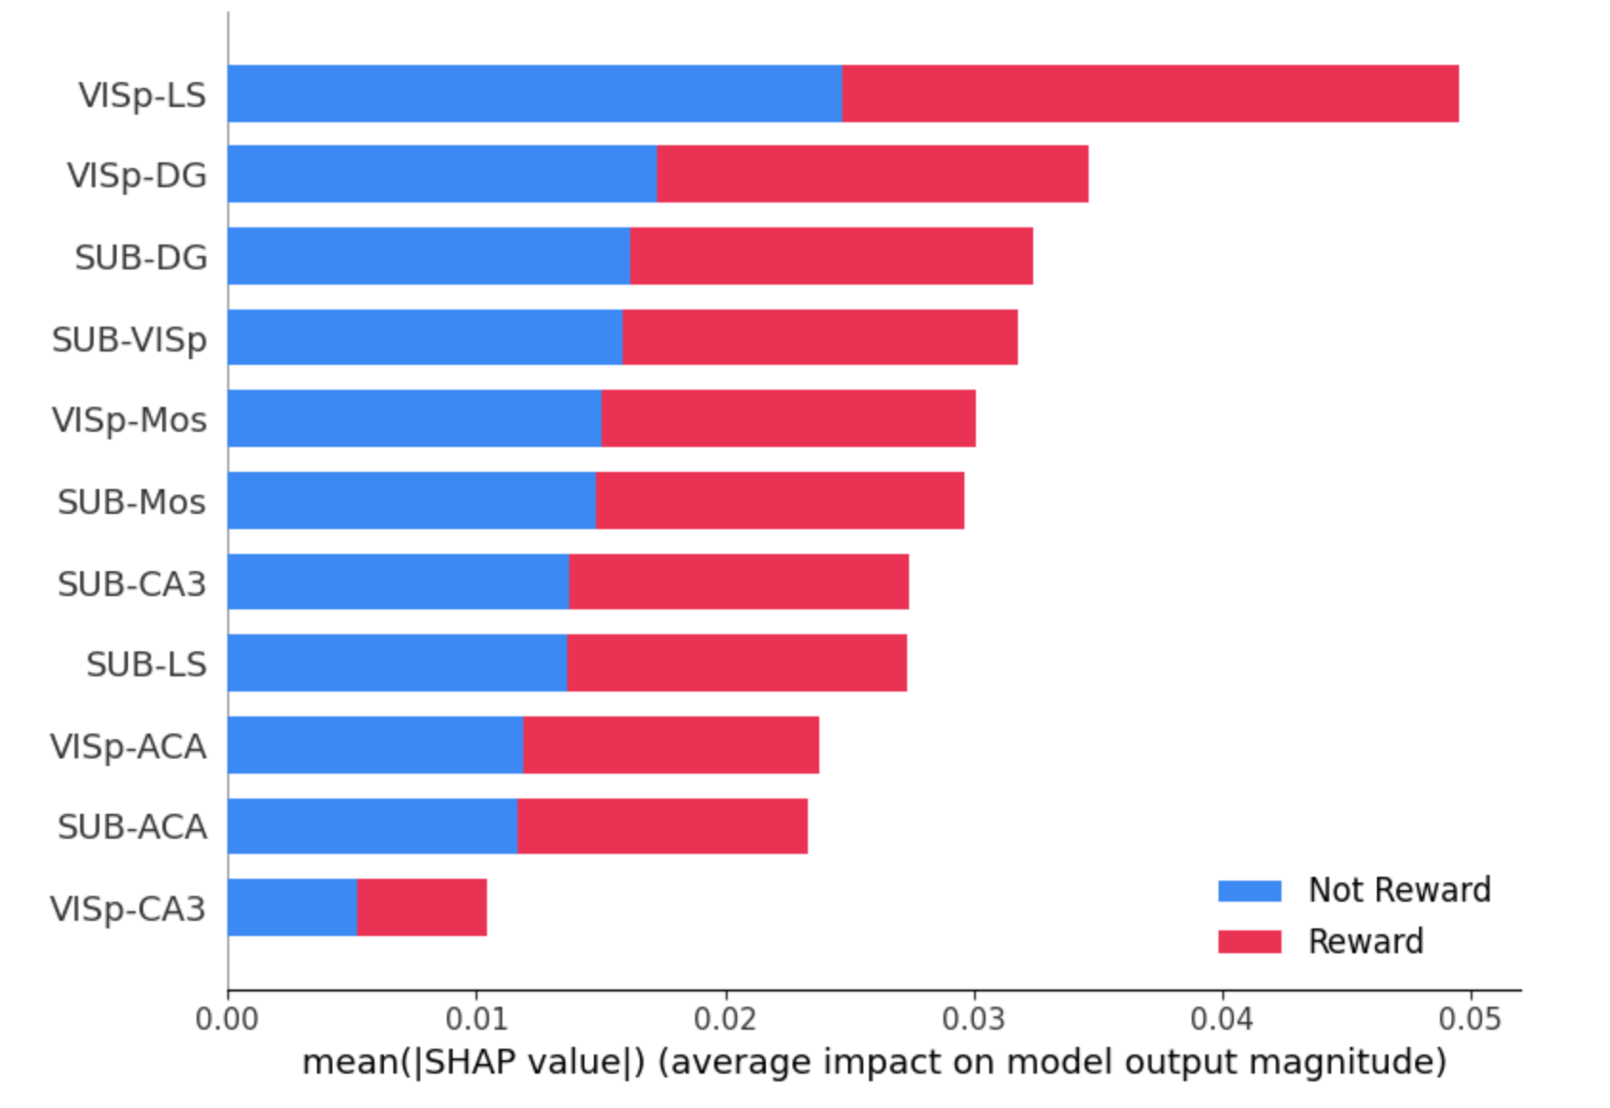
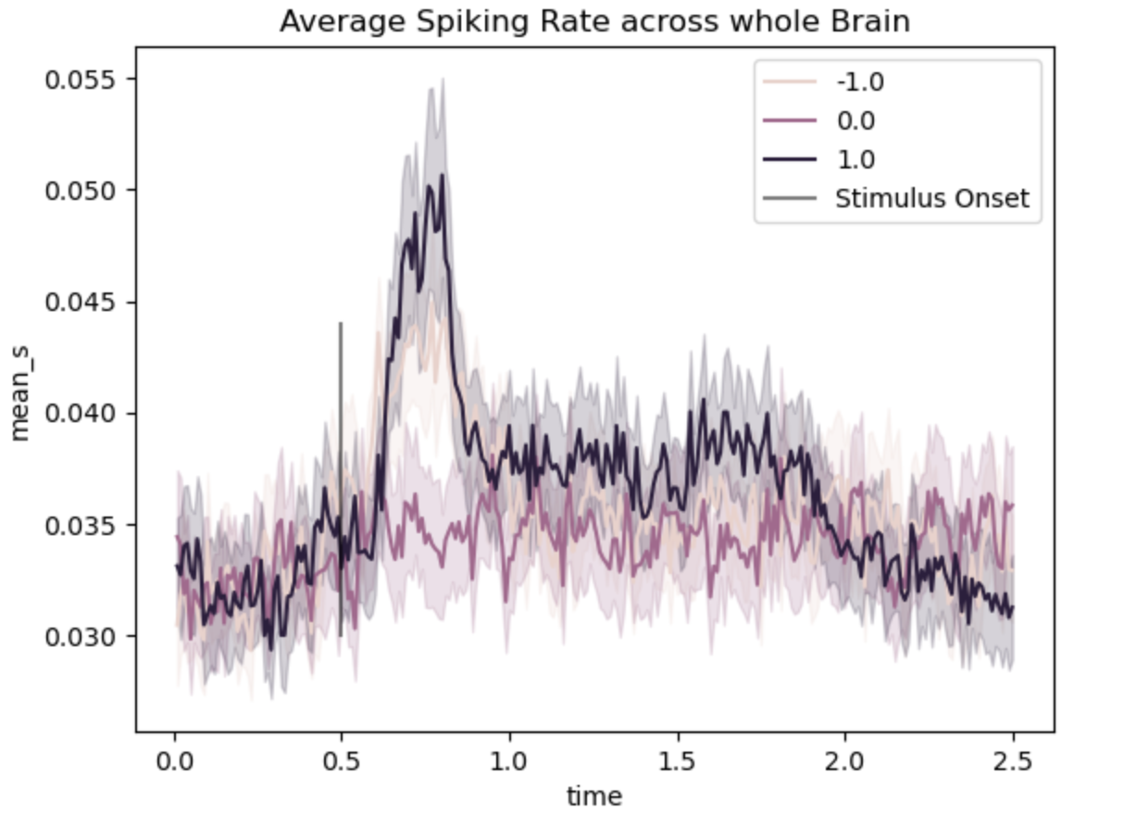
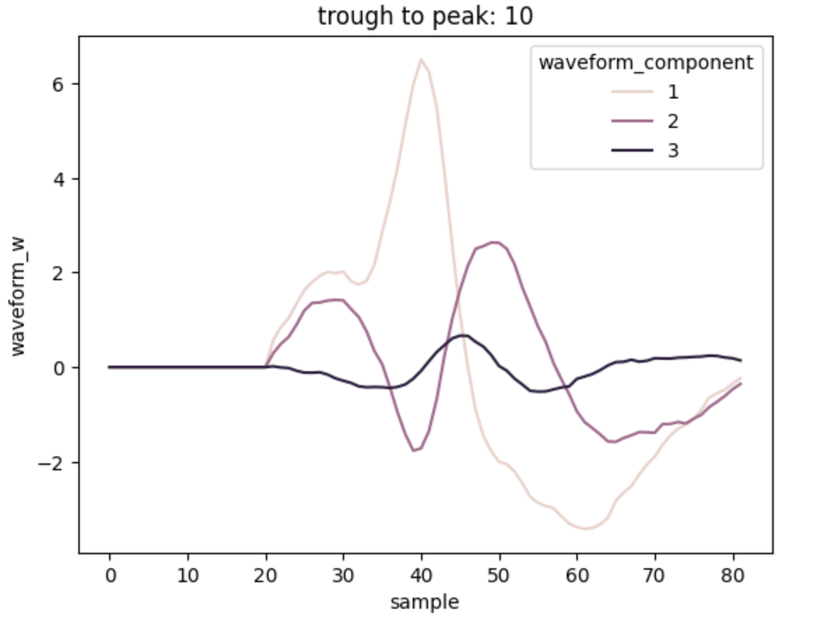
We had fun exploring the data!

